Slide 1
NEIL GOGTE INSTITUTE OF TECHNOLOGY & KESHAV MEMORIAL ENGINEERING COLLEGE
DATA MINING
(PE625CS)
&
(PE622CSM)
By: Dr. P.MANASA
Assistant Professor, CSE.
NGIT

Slide 2
UNIT-II
MINING FREQUENT PATTERNS,ASSOCIATIONS AND CORRELATIONS:
Basic concepts and methods, Frequent Item set Mining Methods, Sequential Pattern Mining Concepts and Pattern evaluation Methods.

Slide 3
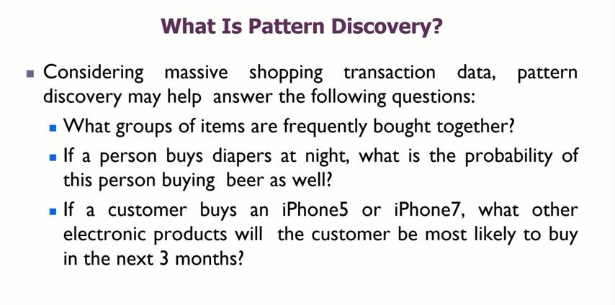

Slide 4
What is frequent pattern analysis?
Frequent patterns are patterns (e.g., itemsets, subsequences, or substructures) that appear frequently in a data set.
For example, a set of items, such as milk and bread, that appear frequently together in a transaction data set is a frequent itemset.
A subsequence, such as buying first a PC, then a digital camera, and then a memory card, if it occurs frequently in a shopping history database, is a (frequent) sequential pattern.
A substructure can refer to different structural forms, such as subgraphs, subtrees, or sublattices, which may be combined with itemsets or subsequences.
If a substructure occurs frequently, it is called a (frequent) structured pattern.

Slide 5
Market Basket Analysis: A Motivating Example
Frequent itemset mining leads to the discovery of associations and
correlations among items in large transactional or relational data sets
A typical example of frequent itemset mining is market basket analysis.
This process analyzes customer buying habits by finding associations between the different items that customers place in their “shopping baskets”
For instance, if customers are buying milk, how likely are they to also buy bread (and what kind of bread) on the same trip to the supermarket? This information can lead to increased sales by helping retailers do selective marketing and plan their shelf space

Slide 6
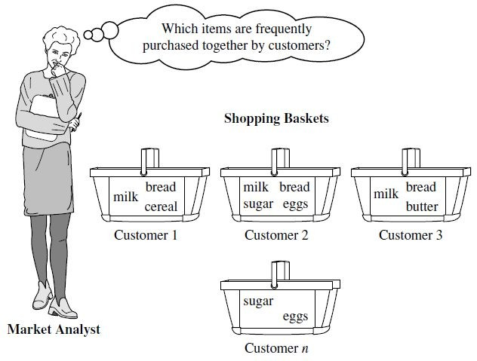

Slide 7
Example Market basket analysis.
Suppose, as manager of an AllElectronics branch, you would like to learn more about the buying habits of your customers. Specifically, you wonder, “Which groups or sets of items are customers likely to purchase on a given trip to the store?”
To answer the question, market basket analysis may be performed on the retail data of customer transactions at your store.
We can then use the results to plan marketing or advertising strategies, or in the design of a new catalog.
In one strategy, items that are frequently purchased together can be placed in proximity to further encourage the combined sale of such items.
If customers who purchase computers also tend to buy antivirus software at the same time, then placing the hardware display close to the software display may help increase the sales of both items.

Slide 8
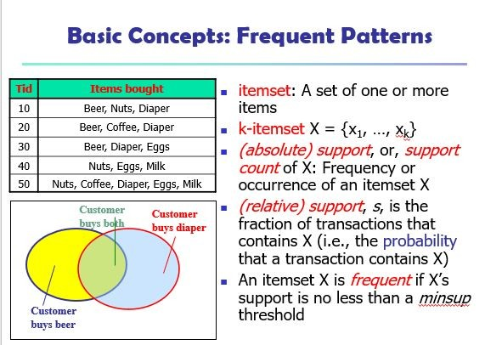
Basic Concepts: Frequent Patterns

Slide 9
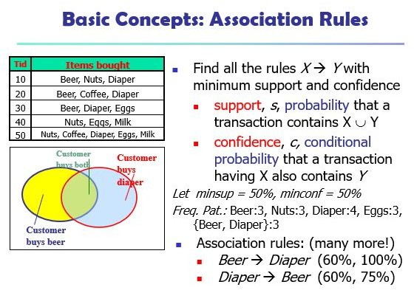

Slide 10
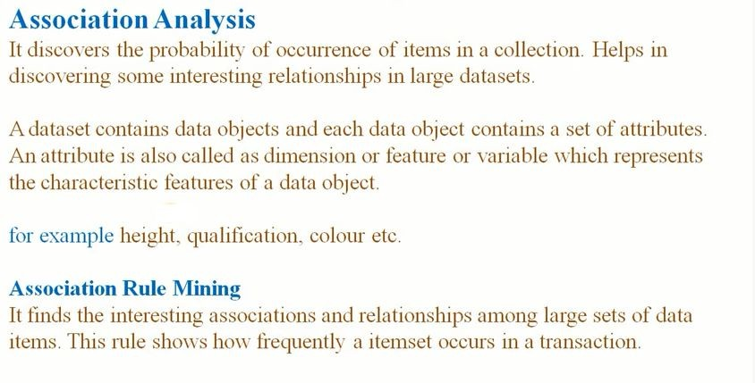

Slide 11
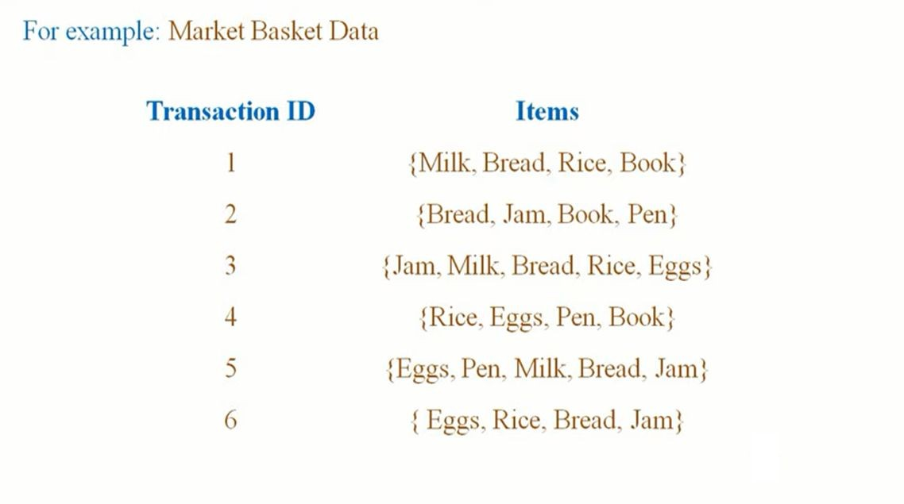

Slide 12
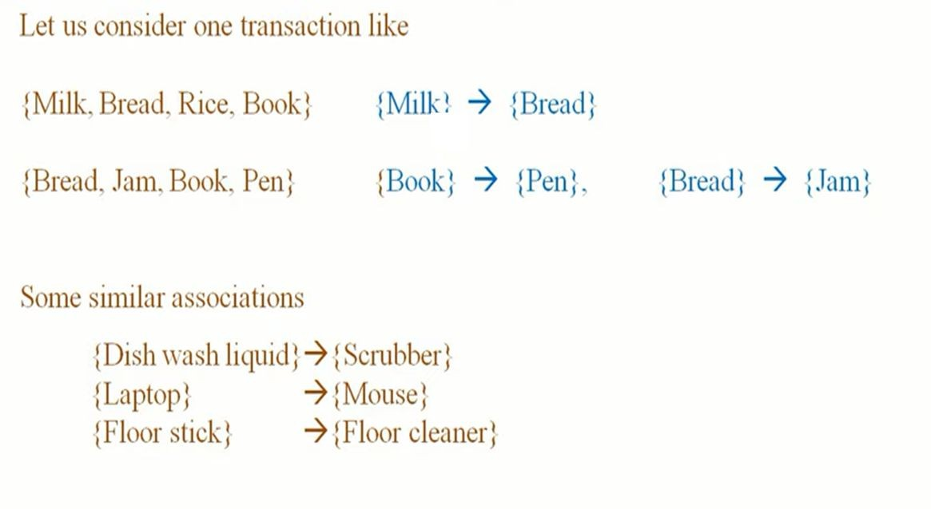

Slide 13
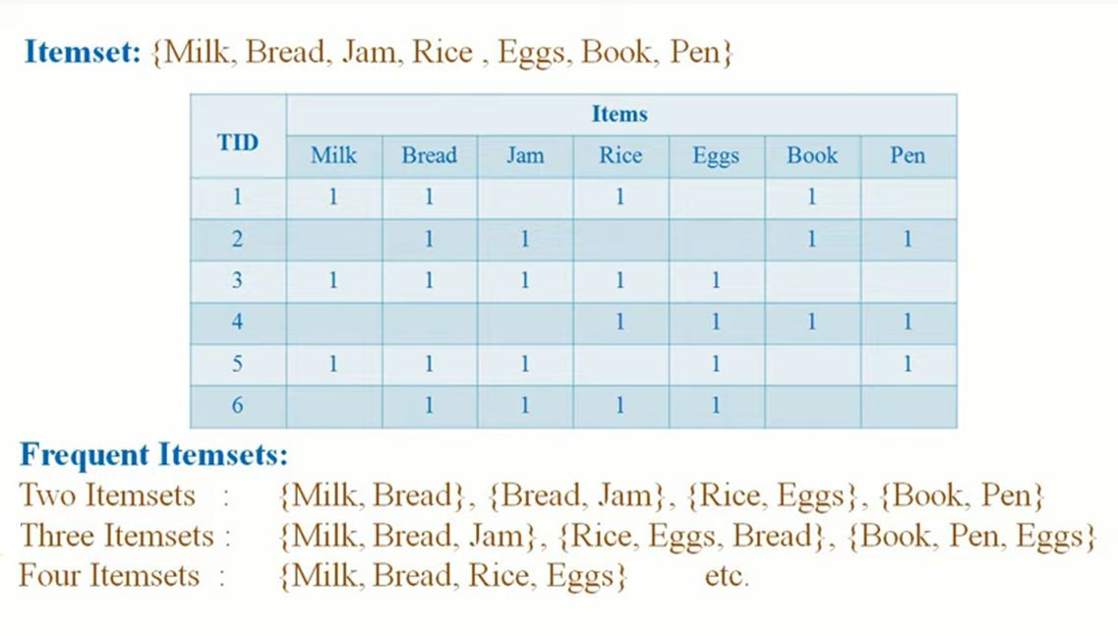

Slide 14
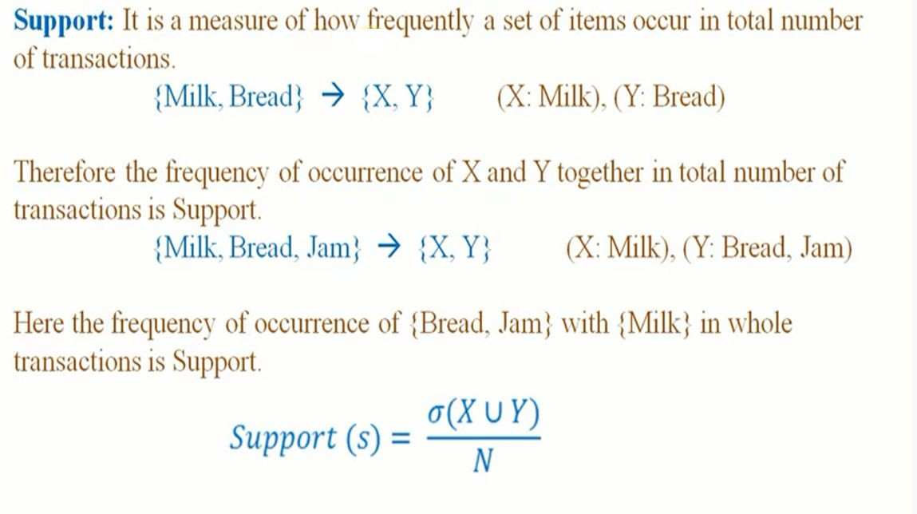

Slide 15
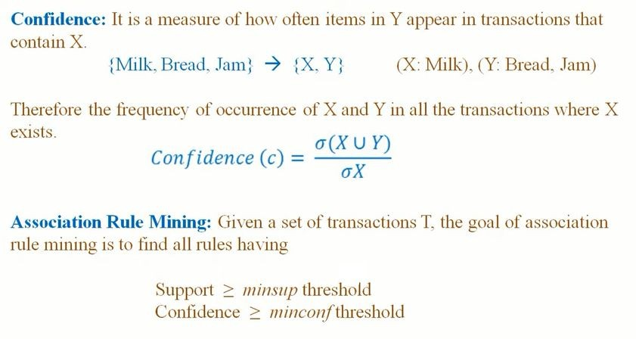

Slide 16
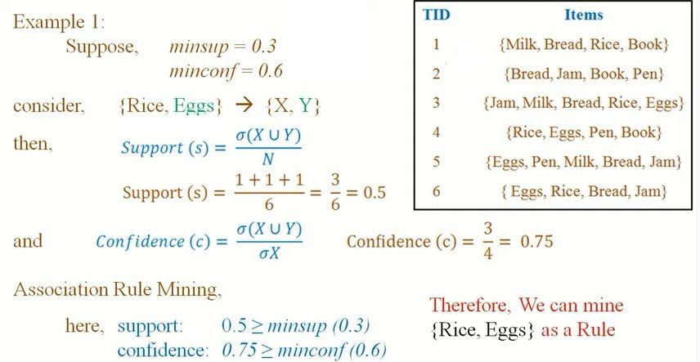

Slide 17
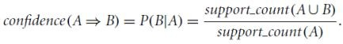
In general, association rule mining can be viewed as a two-step process:
1. Find all frequent itemsets: By definition, each of these itemsets will occur at least as frequently as a predetermined minimum support count, min sup.
Apirori Algorithm
FP-Growth
2. Generate strong association rules from the frequent itemsets: By definition, these rules must satisfy minimum support and minimum confidence.

Slide 18
A misleading “strong” association rule.
Suppose we are interested in analyzing transactions at AllElectronics with respect to the purchase of computer games and videos.
Let game refer to the transactions containing computer games, and video refer to those containing videos.
Of the 10,000 transactions analyzed, the data show that 6000 of the customer transactions included computer games, while 7500 included videos, and 4000 included both computer games and videos.
Suppose that a data mining program for discovering association rules is run on the data, using a minimum support of, say, 30% and a minimum confidence of 60%.

Slide 19
The following association rule is discovered:
buys(X, “computer games”) ⇒ buys(X, “videos”) [support = 40%, confidence = 66%].
Rule is a strong association rule and would therefore be reported, since its support value of 4000 /10,000 = 40% and confidence value of 4000/ 6000 = 66% satisfy the minimum support and minimum confidence thresholds, respectively.
However, Rule is misleading because the probability of purchasing videos is 75%, which is even larger than 66%.
In fact, computer games and videos are negatively associated because the purchase of one of these items decreases the likelihood of purchasing the other.
It does not measure the real strength (or lack of strength) of the correlation and implication between A and B.
Hence, alternatives to the support–confidence framework can be useful in mining interesting data relationships.

Slide 20
From Association Analysis to Correlation Analysis
As we have seen so far, the support and confidence measures are insufficient at filtering out uninteresting association rules.
To tackle this weakness, a correlation measure can be used to augment the support–confidence framework for association rules.
This leads to correlation rules of the form
A ⇒ B [support, confidence, correlation]
That is, a correlation rule is measured not only by its support and confidence but also by the correlation between itemsets A and B.
There are many different correlation measures available.
Let us determine which would be good for mining large data sets.

Slide 21
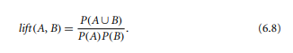
Lift is a simple correlation measure that is given as follows.
The occurrence of itemset A is independent of the occurrence of itemset B if P(A ∪B) = P(A)P(B); otherwise, itemsets A and B are dependent and correlated as events.
This definition can easily be extended to more than two itemsets.
The lift between the occurrence of A and B can be measured by computing
If the resulting value of Eq. (6.8) is less than 1, then the occurrence of A is negatively correlated with the occurrence of B, meaning that the occurrence of one likely leads to the absence of the other one.
If the resulting value is greater than 1, then A and B are positively correlated, meaning that the occurrence of one implies the occurrence of the other.
If the resulting value is equal to 1, then A and B are independent and there is no correlation between them.

Slide 22
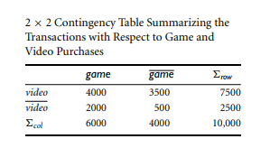

Example -Correlation analysis using lift.
To help filter out misleading “strong” associations of the form A ⇒ B from the data of Previous example, we need to study how the two itemsets, A and B, are correlated.
Let game refer to the transactions of previous example that do not contain computer games, and video refer to those that do not contain videos.
The transactions can be summarized in a contingency table, as shown in Table below.

Slide 23
From the table, we can see that the probability of purchasing a computer game is P({game}) = 0.60, the probability of purchasing a video is P({video}) = 0.75, and the probability of purchasing both is P({game, video}) = 0.40.
By Eq. (6.8), the lift of Rule is P({game, video})/(P({game}) × P({video})) = 0.40/(0.60 × 0.75) = 0.89.
Because this value is less than 1, there is a negative correlation between the occurrence of {game} and {video}.
The numerator is the likelihood of a customer purchasing both, while the denominator is what the likelihood would have been if the two purchases were completely independent.
Such a negative correlation cannot be identified by a support–confidence framework.

Slide 24
The second correlation measure that we study is the χ 2 measure.
To compute the χ 2 value, we take the squared difference between the observed and expected value for a slot (A and B pair) in the contingency table, divided by the expected value.
This amount is summed for all slots of the contingency table.
Let’s perform a χ 2 analysis of Example 6.8.

Slide 25
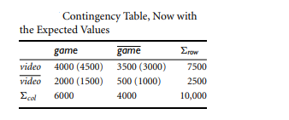
`
To compute the correlation using χ 2 analysis for nominal data, we need the observed value and expected value (displayed in parenthesis) for each slot of the contingency table, as shown in Table below.

Slide 26
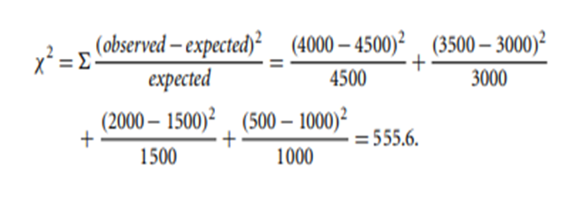
From the table, we can compute the χ 2 value as follows:
Because the χ 2 value is greater than 1, and the observed value of the slot (game, video) = 4000, which is less than the expected value of 4500, buying game and buying video are negatively correlated.
This is consistent with the conclusion derived from the analysis of the lift measure in previous example.

Slide 27
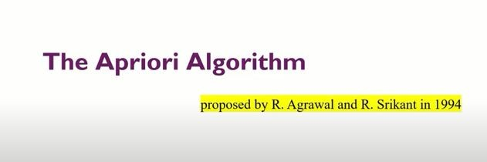
2.2 Frequent Itemset Mining Methods

Slide 28
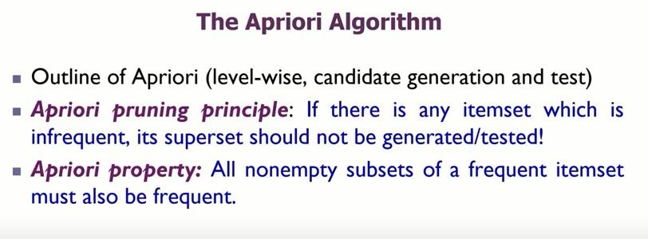
A two-step process is followed, consisting of join and prune actions.
1.JOIN STEP
2.PRUNE STEP

Slide 29
Apriori Algorithm – Frequent Pattern Algorithms
Apriori algorithm was the first algorithm that was proposed for frequent
itemset mining.
Apriori says:
The probability that item I is not frequent is if:
P(I) < minimum support threshold, then I is not frequent.
P (I+A) < minimum support threshold, then I+A is not frequent, where A also belongs to itemset.
If an itemset set has value less than minimum support then all of its
supersets will also fall below min support, and thus can be ignored. This property is called the Antimonotone property.

Slide 30
Steps In Apriori
In Apriori algorithm a sequence of steps to be followed to find the most frequent itemset in the given database. This data mining technique follows the join and the prune steps iteratively until the most frequent itemset is achieved. A minimum support threshold is given in the problem or it is assumed by the user.
#1) In the first iteration of the algorithm, each item is taken as a 1-itemsets candidate. The algorithm will count the occurrences of each item.
#2) Let there be some minimum support, min_sup . The set of 1 – itemsets whose occurrence is satisfying the min sup are determined. Only those candidates which count more than or equal to min_sup, are taken ahead for the next iteration and the others are pruned.

Slide 31
#3) Next, 2-itemset frequent items with min_sup are discovered. For this in
the join step, the 2-itemset is generated by forming a group of 2 by combining items with itself.
#4) The 2-itemset candidates are pruned using min-sup threshold value. Now the table will have 2 –itemsets with min-sup only.
#5) The next iteration will form 3 –itemsets using join and prune step. This
iteration will follow antimonotone property where the subsets of 3-itemsets,
that is the 2 –itemset subsets of each group fall in min_sup. If all 2-itemset subsets are frequent then the superset will be frequent otherwise it is pruned.
#6) Next step will follow making 4-itemset by joining 3-itemset with itself
and pruning if its subset does not meet the min_sup criteria. The algorithm is stopped when the most frequent itemset is achieved.

Slide 32
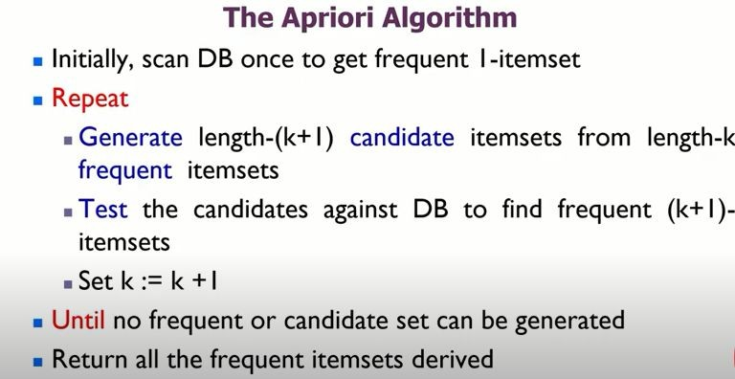

Slide 33
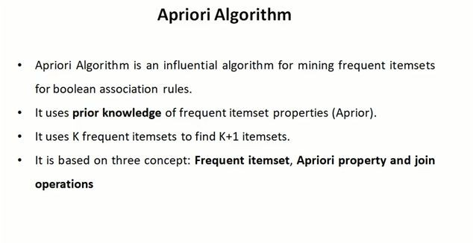

Slide 34
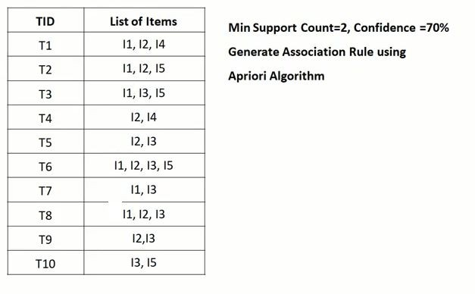

Slide 35
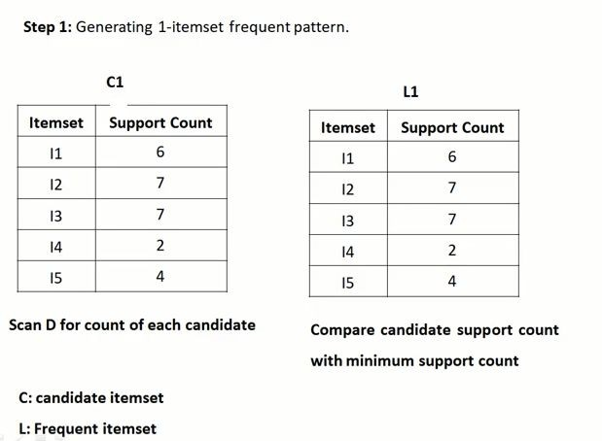

Slide 36
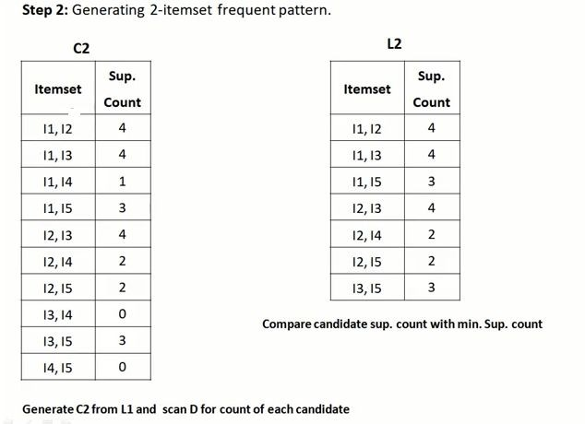

Slide 37
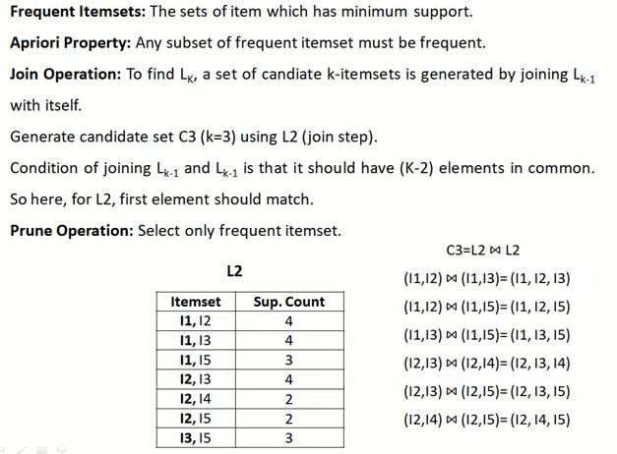

Slide 38
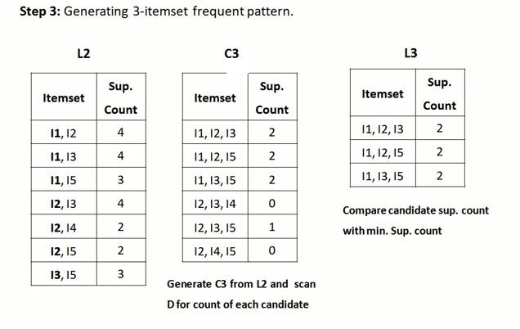

Slide 39
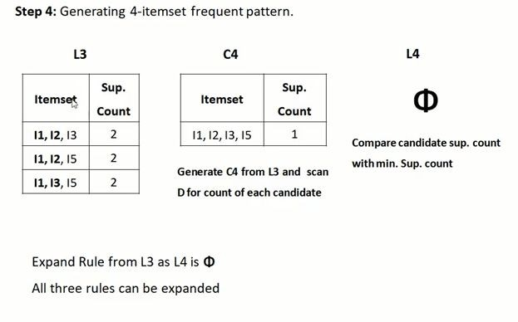

Slide 40
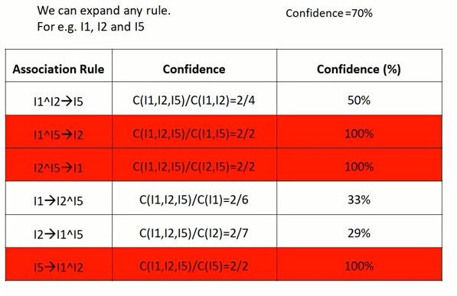

Slide 41
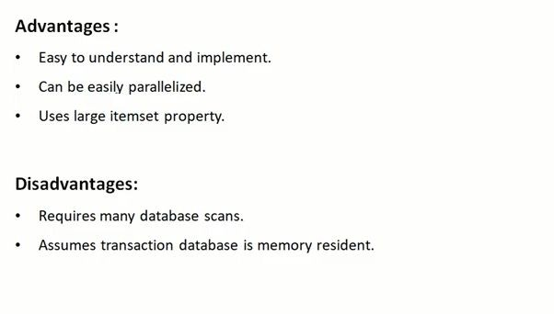

Slide 42
FP Growth Algorithm
The two primary drawbacks of the Apriori Algorithm are:
At each step, candidate sets must be built.
To build the candidate sets, the algorithm must repeatedly scan the database.
These two properties inevitably make the algorithm slower. To overcome these redundant steps, a new association-rule mining algorithm was developed named Frequent Pattern Growth Algorithm.
FP growth is an efficient and scalable method for mining the complete set of FP using a tree structure for storing information about FP called FP tree

Slide 43
The FP-growth algorithm uses the following steps to build FP-tree from the database.
Scan itemsets from the database for the first time
Find frequent items (single item patterns) and order them into a list L in frequency descending order. For example, L = {A:5, C:3, D;2, B:1}
For each transaction order its frequent items according to the order in L
Scan the database the second time and construct FP-tree by putting each frequency ordered transaction onto it

Slide 44
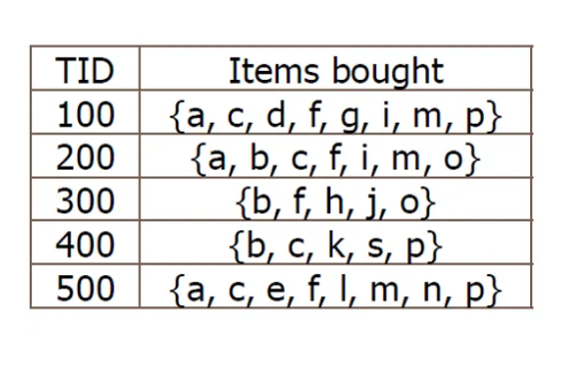
min_sup=3

Slide 45
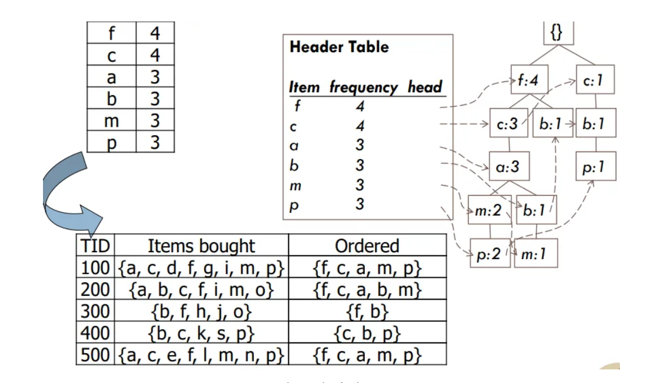

Slide 46
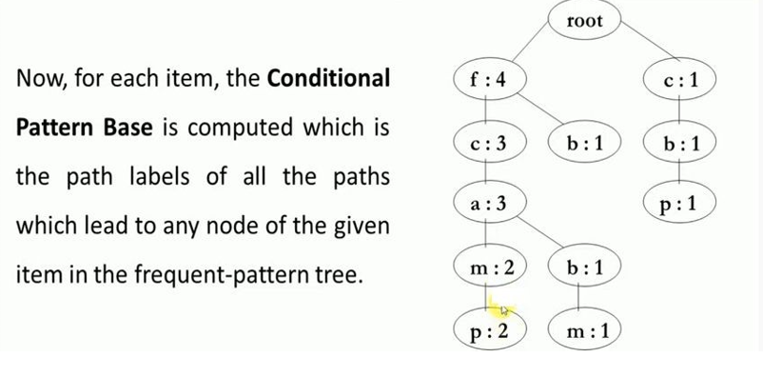

Slide 47
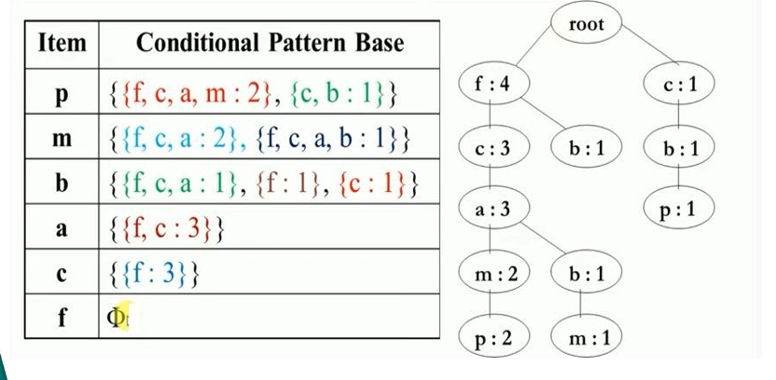

Slide 48
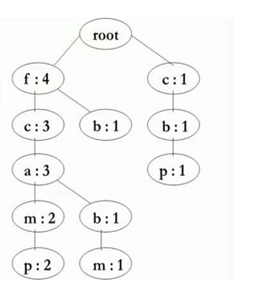
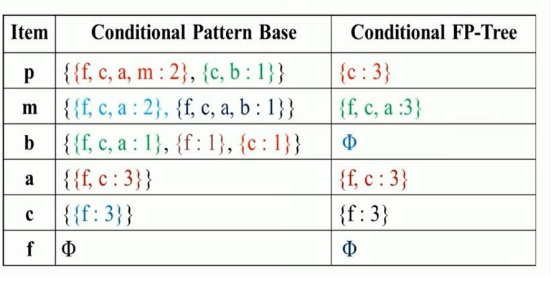

Slide 49
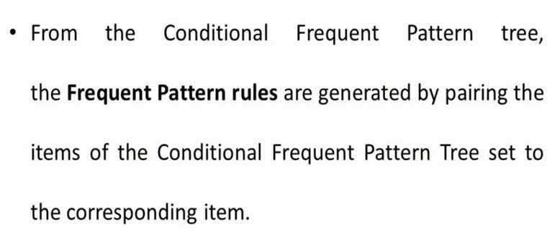

Slide 50
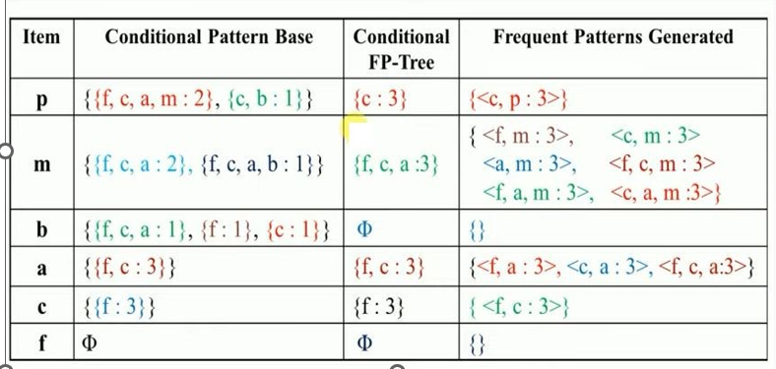

Slide 51
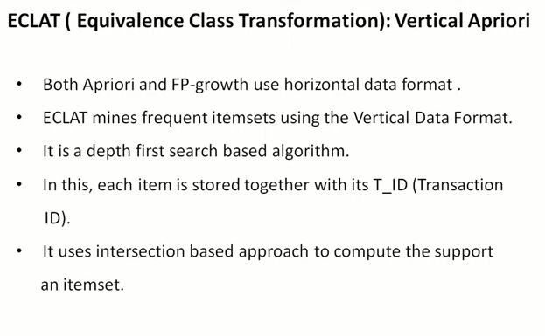
Mining frequent itemset using vertical data format
Vertical data format is referred to data containing items that is presented in a format paired as(item_name,set_of_tranID)
STEPS
Convert/transform horizontal data to vertical data format
Compute Frequent k itemset where (k=1,2,3.4….)which can be used to construct (k+1) item set
The above step continues until no further frequent or conditional item set are found

Slide 52
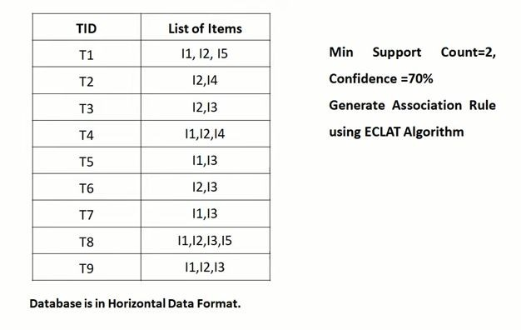

Slide 53
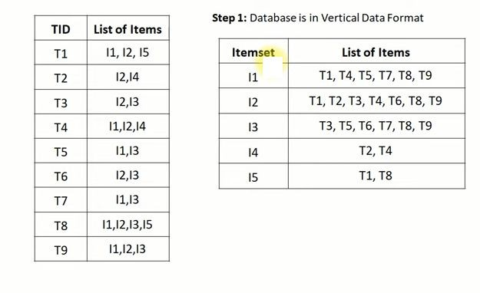

Slide 54
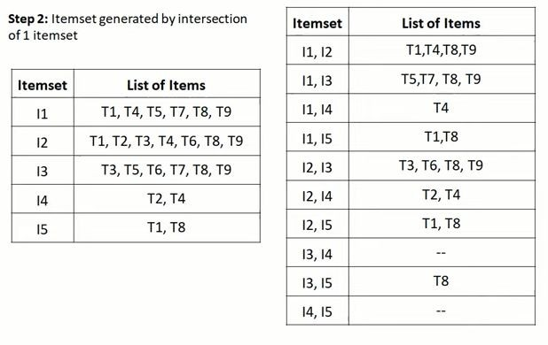

Slide 55
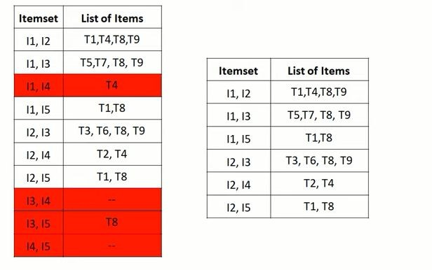

Slide 56
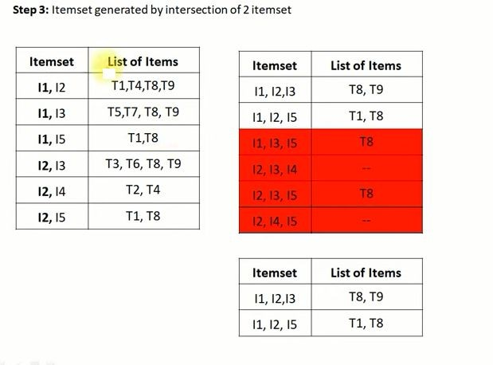

Slide 57
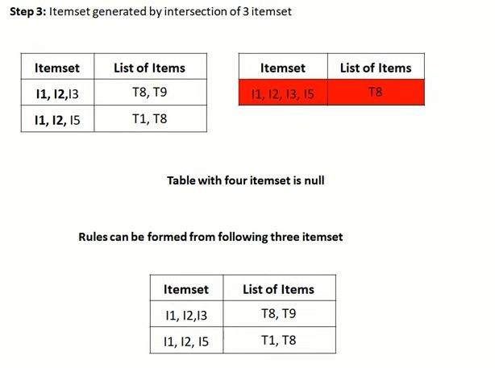

Slide 58
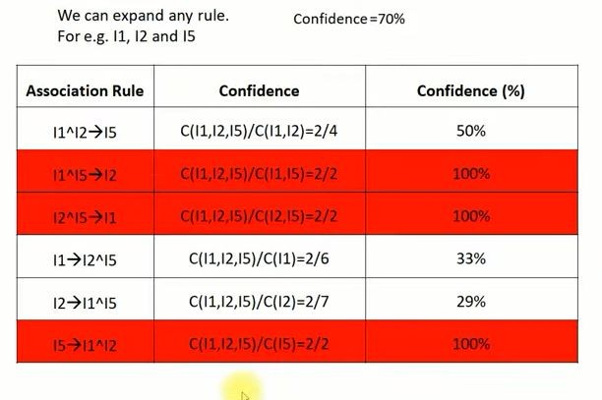

Slide 59
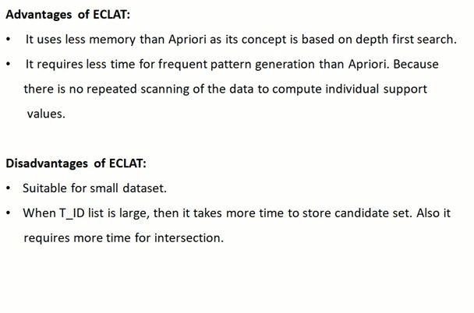

Slide 60
Sequential Pattern Mining ( SPM )
Sequence=set of ordered events
Example :s={e1,e2,e3,e4,e5}
SPM->process of finding frequent subsequences from a set of sequences
Sequences are represented by < >

Slide 61


Sequence Databases
A sequence database consists of ordered elements or events
Transaction databases vs. sequence databases
A transaction database A sequence database
TID | itemsets
10 | a, b, d
20 | a, c, d
30 | a, d, e
40 | b, e, f
SID | sequences
10 | <a(abc)(ac)d(cf)>
20 | <(ad)c(bc)(ae)>
30 | <(ef)(ab)(df)cb>
40 | <eg(af)cbc>
61

Slide 62



What Is Sequential Pattern Mining?
Given a set of sequences and support threshold, find the complete set of frequent subsequences
A sequence database
A sequence : <
(df) | c | b
(ef) (ab) >
SID | sequence
10 | <a(abc)(ac)d(cf)>
20 | <(ad)c(bc)(ae)>
30 | <(ef)(ab)(df)cb>
40 | <eg(af)cbc>
An element may contain a set of items. Items within an element are unordered and we list them alphabetically.
<a(bc)dc> is a subsequence
of <a(abc)(ac)d(cf)>
Given support threshold min_sup =2, <(ab)c> is a
sequential pattern
6

Slide 63

The Apriori Property of Sequential Patterns
A basic property: Apriori (Agrawal & Sirkant’94)
If a sequence S is not frequent, then none of the super-sequences of S is frequent
E.g, <hb> is infrequent so do <hab> and
<(ah)b>

Slide 64
GSP—Generalized Sequential Pattern Mining
GSP (Generalized Sequential Pattern) mining algorithm
Outline of the method
Initially, every item in DB is a candidate of length-1
for each level (i.e., sequences of length-k) do
scan database to collect support count for each candidate sequence
generate candidate length-(k+1) sequences from length-k frequent sequences using Apriori
repeat until no frequent sequence or no candidate can be found
11

Slide 65
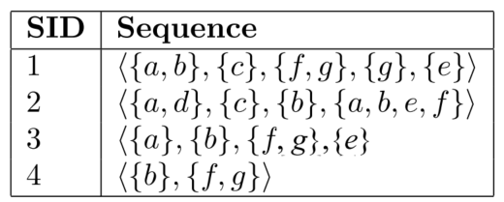
GSP (Generalised Sequential Patterns)
1- length Seq | Support
{a} | 3
{b} | 4
{c} | 2
{d} | 1
{e} | 3
{f} | 4
{g} | 3
Min sup =2

Slide 66
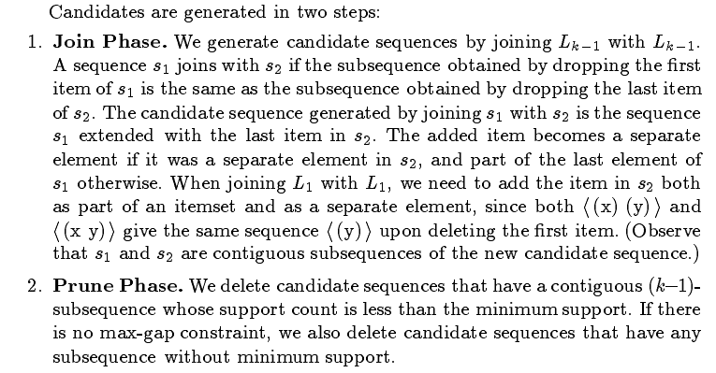

Slide 67
1- length Seq | Support
{a} | 3
{b} | 4
{c} | 2
{e} | 3
{f} | 4
{g} | 3
2-len Seq ( a )
{ab} | 2
{ac} | 2
{ae} | 3
{af} | 3
{ag} | 2
{(a,b)} | 2
{(a,c)} | 0
{(a,e)} | 1
{(a,f)} | 1
{(a,g)} | 0
{ab} not equal to {ba}
{(a,b)} equal to {(b,a)}

Slide 68
1- length Seq | support
{a} | 3
{b} | 4
{c} | 2
{e} | 3
{f} | 4
{g} | 3
2-len Seq ( a )
{ab}
{ac}
{ae}
{af}
{ag}
{(a,b)}
{(a,c)}
{(a,e)}
{(a,f)}
{(a,g)}
2-len Seq ( b )
{ba}
{bc}
{be}
{bf}
{bg}
{(b,c)}
{(b,e)}
{(b,f)}
{(b,g)}
2-len Seq ( c )
{ca}
{cb}
{ce}
{cf}
{cg}
{(c,e)}
{(c,f)}
{(c,g)}
2-len Seq ( e )
{ea}
{eb}
{ec}
{ef}
{eg}
{(e,f)}
{(e,g)}
2-len Seq ( f )
{fa}
{fb}
{fc}
{fe}
{fg}
{(e,g)}
2-len Seq ( g )
{ga}
{gb}
{gc}
{ge}
{gf}

Slide 69
2-len Seq ( a ) |  | 2-len Seq ( b ) |  | 2-len Seq ( c ) |  | 2-len Seq ( e ) |  | 2-len Seq ( f ) |  | 2-len Seq ( g )
{ab} | 2 | {ba} | 1 | {ca} | 1 | {ea} | 0 | {fa} | 0 | {ga} | 0
{ac} | 2 | {bc} | 1 | {cb} | 1 | {eb} | 0 | {fb} | 0 | {gb} | 0
{ae} | 3 | {be} | 3 | {ce} | 2 | {ec} | 0 | {fc} | 0 | {gc} | 0
{af} | 3 | {bf} | 4 | {cf} | 2 | {ef} | 0 | {fe} | 2 | {ge} | 2
{ag} | 2 | {bg} | 3 | {cg} | 1 | {eg} | 0 | {fg} | 1 | {gf} | 0
{(a,b)} | 2 | {(b,c)} | 0 | {(c,e)} | 0 | {(e,f)} | 1 | {(f,g)} | 3
{(a,c)} | 0 | {(b,e)} | 1 | {(c,f)} | 0 | {(e,g)} | 1
{(a,e)} | 1 | {(b,f)} | 1 | {(c,g)} | 0
{(a,f)} | 1 | {(b,g)} | 1
{(a,g)} | 0

Slide 71
2-len Seq
{ab} | 2
{ac} | 2
{ae} | 3
{af} | 3
{ag} | 2
{(a,b)} | 2
{be} | 3
{bf} | 4
{bg} | 3
{ce} | 2
{cf} | 2
{fe} | 2
{(f,g)} | 3
{ge} | 2
{ab} {ae} {be}
{cf} {cg} {(f,g)}
3-len Seq
{abe} | {(ab)f}
{abf} | {(ab)g}
{abg} | {bfe}
{ace} | {b(f,g)}
{acf} | {bge}
{afe} | {cfe}
{a(f,g)} | {c(f,g)}
{age} | {(f,g)e}
{(ab)e}
{ab} {ac}
{ab} {be} {abe}
{(a,b)} {be} {(a,b)e}
{bf} { (f,g) } { b(f,g) }

Slide 72
3-len Seq
{abe} | 2 | {(ab)e} | 1
{abf} | 2 | {(ab)f} | 1
{abg} | 1 | {(ab)g} | 1
{ace} | 2 | {bfe} | 2
{acf} | 2 | {b(f,g)} | 3
{afe} | 2 | {bge} | 2
{a(f,g)} | 2 | {cfe} | 1
{age} | 2 | {(f,g)e} | 2

Slide 73
3-len Seq
{abe} | 2
{abf} | 2
{ace} | 2
{acf} | 2
{afe} | 2
{a(f,g)} | 2
{age} | 2
{bfe} | 2
{b(f,g)} | 3
{bge} | 2
{(f,g)e} | 2
{abf}{bfe} {abfe}
{abf}{bge}
4-len Seq
{abfe} | 2
{ab(f,g)} | 1
{a(f,g)e} | 2
{b(f,g)e} | 2

Slide 74
1- length Seq
{a} | 3
{b} | 4
{c} | 2
{e} | 3
{f} | 4
{g} | 3
2-len Seq
{ab} | 2
{ac} | 2
{ae} | 3
{af} | 3
{ag} | 2
{(a,b)} | 2
{be} | 3
{bf} | 4
{bg} | 3
{ce} | 2
{cf} | 2
{fe} | 2
{(f,g)} | 3
{ge} | 2
3-len Seq
{abe} | 2
{abf} | 2
{ace} | 2
{acf} | 2
{afe} | 2
{a(f,g)} | 2
{age} | 2
{bfe} | 2
{b(f,g)} | 3
{bge} | 2
{(f,g)e} | 2
4-len Seq
{abfe} | 2
{a(f,g)e} | 2
{b(f,g)e} | 2

Slide 75
How to Judge if a Rule/Pattern Is Interesting?
Pattern-mining will generate a large set of patterns/rules
🞑 Not all the generated patterns/rules are interesting
Interestingness measures: Objective vs. subjective
🞑 Objective interestingness measures
Support, confidence, correlation, …
🞑 Subjective interestingness measures:
Different users may judge interestingness differently
Let a user specify
Query-based: Relevant to a user’s particular request
Judge against one’s knowledge base
unexpected, freshness, timeliness

Slide 76
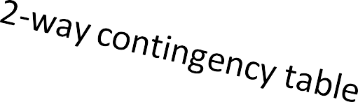
Limitation of the Support-Confidence Framework
Are s and c interesting in association rules: “A ⇒ B” [s, c]?
Example: Suppose one school may have the following statistics on # of students
who may play basketball and/or eat cereal:
 | play-basketball | not play-basketball | sum (row)
eat-cereal | 400 | 350 | 750
not eat-cereal | 200 | 50 | 250
sum(col.) | 600 | 400 | 1000
Association rule mining may generate the following:
🞑 play-basketball ⇒ eat-cereal [40%, 66.7%] (higher s & c)
But this strong association rule is misleading: The overall % of students eating
cereal is 75% > 66.7%, a more telling rule:
¬ play-basketball ⇒ eat-cereal [35%, 87.5%] (high s & c)

Slide 77
Interestingness Measure: Lift
Measure of dependent/correlated events: lift
Lift is more telling than s & c
s(B∪ C)
 | B | ¬B | ∑row
C | 400 | 350 | 750
¬C | 200 | 50 | 250
∑col. | 600 | 400 | 1000
lift(B, C) = ^{c(B→ C)} =
s(C) s(B) × s(C)
Lift(B, C) may tell how B and C are correlated
Lift(B, C) = 1: B and C are independent
> 1: positively correlated
< 1: negatively correlated
In our example,
lift(B, C) =
400 /1000
= 0.89
600 /1000× 750 /1000
lift(B, ¬C) =
200 /1000
= 1.33
600 /1000× 250 /1000
Thus, B and C are negatively correlated since lift(B, C) < 1;
B and ¬C are positively correlated since lift(B, ¬C) > 1

Slide 78
Interestingness Measure: χ²
 | B | ¬B | ∑row
C | 400 (450) | 350 (300) | 750
¬C | 200 (150) | 50 (100) | 250
∑col | 600 | 400 | 1000
Another measure to test correlated events: χ
2
_{χ}2
= ∑
(Observed − Expected )²
Expected
For the table on the right,
Expected value
_{χ 2 =} (400 − 450)² ₊ (350 − 300)² ₊ (200 −150)² ₊ (50 −100)²
450 300 150 100
Observed value
= 55.56
By consulting a table of critical values of the χ² distribution, one can conclude that the chance for B and C to be independent is very low (< 0.01)
χ²-test shows B and C are negatively correlated since the expected value is 450 but the observed is only 400
Thus, χ² is also more telling than the support-confidence framework

Slide 79
Lift and χ² : Are They Always Good Measures?
Null transactions: Transactions that contain neither B nor C
Let’s examine the new dataset D
🞑 BC (100) is much rarer than B¬C (1000) and ¬BC (1000),
but there are many ¬B¬C (100000)
🞑 Unlikely B & C will happen together!
 | B | ¬B | ∑row
C | 100 | 1000 | 1100
¬C | 1000 | 100000 | 101000
∑col. | 1100 | 101000 | 102100
null transactions
Contingency table with expected values added
 | B | ¬B | ∑row
C | 100 (11.85) | 1000 | 1100
¬C | 1000 (988.15) | 100000 | 101000
∑col. | 1100 | 101000 | 102100
But, Lift(B, C) = 8.44 >> 1 (Lift shows B and C are strongly positively correlated!)
χ² = 670: Observed(BC) >> expected value (11.85)
Too many null transactions may “spoil the soup”!

Slide 80
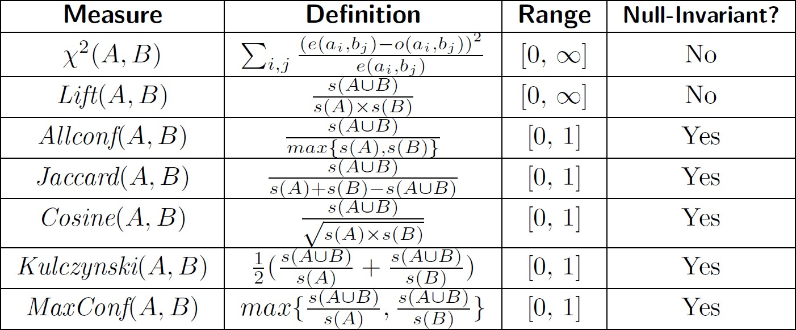
Interestingness Measures & Null-Invariance
Null invariance: Value does not change with the # of null-transactions
A few interestingness measures: Some are null invariant
Χ² and lift are not null-invariant
Jaccard, consine, AllConf, MaxConf, and Kulczynski are null-invariant measures

Slide 81
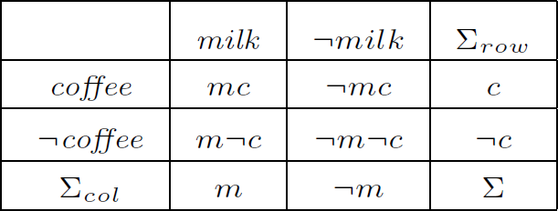

Null Invariance: An Important Property
Why is null invariance crucial for the analysis of massive transaction data?
🞑 Many transactions may contain neither milk nor coffee!
milk vs. coffee contingency table
Lift and χ² are not null-invariant: not good to evaluate data that contain too many or too few null transactions!
Many measures are not null-invariant!
Null-transactions
w.r.t. m and c

Slide 82


Comparison of Null-Invariant Measures
Not all null-invariant measures are created equal
Which one is better?
🞑 D₄—D₆ differentiate the null-invariant measures
🞑 Kulc (Kulczynski 1927) holds firm and is in balance of both directional implications
2-variable contingency table
All 5 are null-invariant
Subtle: They disagree on those cases

Slide 83


Imbalance Ratio with Kulczynski Measure
IR (Imbalance Ratio): measure the imbalance of two itemsets A and B in rule implications:
Kulczynski and Imbalance Ratio (IR) together present a clear picture for all the three
datasets D₄ through D₆
🞑 D₄ is neutral & balanced; D₅ is neutral but imbalanced
🞑 D₆ is neutral but very imbalanced

Slide 84
What Measures to Choose for Effective Pattern Evaluation?
Null value cases are predominant in many large datasets
🞑 Neither milk nor coffee is in most of the baskets; neither Mike nor Jim is an author in most of the
papers; ……
Null-invariance is an important property
Lift, χ² and cosine are good measures if null transactions are not predominant
🞑 Otherwise, Kulczynski + Imbalance Ratio should be used to judge the interestingness of a pattern

